Slide 1
What’s New in OWL 2?
Four kinds of new features:
Increased expressive power
qualified cardinality restrictions, e.g.:
persons having two friends who are republicans
property chains, e.g.:
the brother of your parent is your uncle
local reflexivity restrictions, e.g.:
narcissists love themselves
reflexive, irreflexive, and asymmetric properties, e.g.:
nothing can be a proper part of itself (irreflexive)
disjoint properties, e.g.:
you can’t be both the parent of and child of the same person
keys, e.g.:
country + license plate constitute a unique identifier for vehicles

Slide 2


What’s New in OWL 2?
Four kinds of new features:
Extended Datatypes
Much wider range of XSD Datatypes supported, e.g.:
Integer, string, boolean, real, decimal, float, datetime, …
User-defined datatypes using facets, e.g.:
max weight of an airmail letter: xsd:integer maxInclusive ”20"^^xsd:integer
format of Italian registration plates: xsd:string xsd:pattern "[A-Z]{2} [0-9]{3}[A-Z]{2}

Slide 3
What’s New in OWL 2?
Four kinds of new features:
Metamodelling and annotations
Restricted form of metamodelling via “punning”, e.g.:
SnowLeopard subClassOf BigCat (i.e., a class)
SnowLeopard type EndangeredSpecies (i.e., an individual)
Annotations of axioms as well as entities, e.g.:
SnowLeopard type EndangeredSpecies (“source: WWF”)
Even annotations of annotations

Slide 4
What’s New in OWL 2?
Four kinds of new features:
Syntactic sugar
Disjoint unions, e.g.:
Element is the DisjointUnion of Earth Wind Fire Water
i.e., Element is equivalent to the union of Earth Wind Fire Water
Earth Wind Fire Water are pair-wise disjoint
Negative assertions, e.g.:
Mary is not a sister of Ian
21 is not the age of Ian

Slide 5
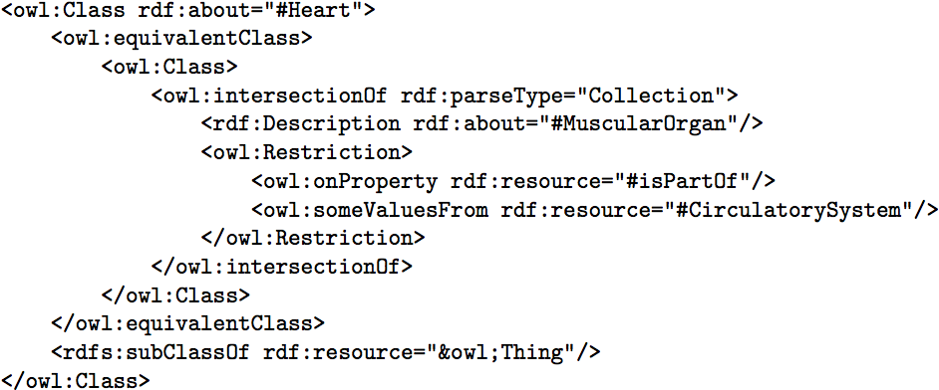
Alternative Syntaxes
Normative exchange syntax is RDF/XML

Slide 6
Alternative Syntaxes
Normative exchange syntax is RDF/XML
Functional syntax mainly intended for language spec

Slide 7
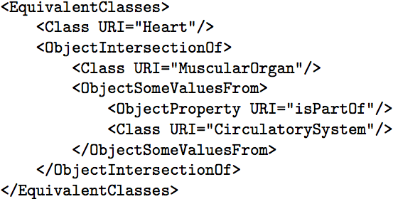
Alternative Syntaxes
Normative exchange syntax is RDF/XML
Functional syntax mainly intended for language spec
XML syntax for interoperability with XML toolchain

Slide 8

Alternative Syntaxes
Normative exchange syntax is RDF/XML
Functional syntax mainly intended for language spec
XML syntax for interoperability with XML toolchain
Manchester syntax for better readability

Slide 9
Syntactic sugar
OWL 2 adds syntactic sugar to make some common patterns easier to write.
All these constructs are simply shorthands
They do not change the expressiveness, semantics, or complexity of the language
Implementations should take special notice of these constructs for more efficient processing.

Slide 10
DisjointUnion
While OWL 1 provides means to define a set of subclasses as a disjoint and complete covering of a superclass by using several axioms, this cannot be done concisely.
DisjointUnion defines a class as the union of other classes, all of which are pairwise disjoint.
It is a shorthand for separate axioms making the classes pairwise disjoint and one setting up the union class.
:Apartment rdf:type owl:Class;
owl:disjointUnionOf (
:FurnishedApartment
:UnFurnishedApartment ) .

Slide 11
DisjointClasses
While OWL 1 provides means to state that two subclasses are disjoint, stating that several subclasses are pairwise disjoint cannot be done concisely.
DisjointClasses states that all classes from the set are pairwise disjoint.
It is a shorthand for binary disjointness axioms between the classes.
_:x rdf:type owl:AllDisjointClasses.
_:x owl:members (:Professor :AssistantProfessor :AssociateProfessor ).

Slide 12
NegativePropertyAssertion
While OWL 1 provides means to assert values of a property for an individual, it does not provide a construct for directly asserting values that an individual does not have (negative facts).
Sometimes we know something not to be the case.
Making this knowledge explicit can be very valuable in an open world: ruling out possibilities often allows us to infer new knowledge.
NegativePropertyAssertion states that a given property does not hold for the given individuals or literals

Slide 13
Negative Property Assertion Example
For instance, the knowledge that :BaronWayApartment is not rented by :Frank may allow us to infer that it is not :FranksApartment
_:x rdf:type owl:NegativePropertyAssertion ;
owl:sourceIndividual :BaronWayApartment ;
owl:assertionProperty :isRentedBy ;
owl:targetIndividual :Frank .
If the owl:assertionProperty points to datatype property, we use owl:targetValue instead of owl:targetIndividual.
Subject
Predicate
Object

Slide 14
New constructs for properties
OWL 1 was mainly focused on constructs for expressing information about classes and individuals, and exhibited some weakness regarding expressiveness for properties.
OWL 2 offers new constructs for expressing:
additional restrictions on properties,
new characteristics of properties,
incompatibility of properties,
property chains and
keys.

Slide 15
Self Restriction
OWL 1 does not allow for the definition of classes of objects that are related to themselves by a given property
E.g. the class of processes that regulate themselves.
This "local reflexivity" is useful in many applications, particularly when global reflexivity does not hold for a property in general, but local reflexivity holds for some classes of object.
The OWL 2 construct hasSelf allows local reflexivity to be used in class descriptions.
A class expression defined using an hasSelf restriction denotes the class of all objects that are related to themselves via the given object property.

Slide 16
Self Restriction - Example
Good apartments will sell themselves; if it is in a good location, with an nice view and has proper size, you don’t need to spend much time redecorating it for it to sell well.
ex:GoodApartment rdf:type owl:Class ;
rdfs:subClassOf [ rdf:type owl:Restriction ;
owl:onProperty ex:sells ;
owl:hasSelf "true"^^xsd:boolean ;
] .
Every instance of ex:GoodApartment is related to its self with ex:sells property.
OWL2 DL does not allow self restrictions on datatype properties.

Slide 17
Property Qualified Cardinality Restrictions
OWL 1 allows restrictions on the number of values of a property
E.g., defining persons that have at least three children
OWL 1 cannot restrain the class or data range of the instances to be counted (qualified cardinality restrictions)
E.g., specifying the class of persons that have at least three children who are girls.
OWL 2 allows both qualified and unqualified cardinality restrictions.
minQualifiedCardinality, maxQualifiedCardinality, qualifiedCardinality allow for the assertion of minimum, maximum or exact qualified cardinality restrictions

Slide 18
Property Qualified Cardinality Restrictions – Example (1/2)
Unqualified example:
:StudioApartment rdf:type owl:Class;
rdfs:subClassOf [ rdf:type owl:Restriction;
owl:onProperty :hasRoom ;
owl:cardinality "1"^^xsd:integer
] .
This specifies that a studio apartment can have exactly one value for the :hasRoom property

Slide 19
Property Qualified Cardinality Restrictions – Example (2/2)
We can turn the previous example into a qualified cardinality restriction by stating that the cardinality holds for members of the :Bedroom class only
:StudioApartment rdf:type owl:Class;
rdfs:subClassOf [ rdf:type owl:Restriction;
owl:onProperty :hasRoom;
owl:qualifiedCardinality "1"^^xsd:integer ;
owl:onClass :Bedroom ] .
The qualified restriction still allows for the members of the restricted class to have additional values for the property, provided that these belong to the complement of the qualifier class.

Slide 20
Reflexive and Irreflexive Object Properties
In OWL 1, it is impossible to assert that the property is reflexive, irreflexive or asymmetric.
Only symmetric or transitive
Reflexivity of a property means that every individual is related via that property to itself.
:isPartOf rdf:type owl:ObjectProperty ;
rdf:type owl:ReflexiveProperty .
Irreflexivity: no individual is related to itself via that property.
:rents rdf:type owl:ObjectProperty ;
rdf:type owl:IrreflexiveProperty .
Most properties with disjoint domain and range are actually irreflexive

Slide 21
Asymmetric Object Properties
The OWL2 construct AsymmetricProperty allows an object property to be defined as asymmetric
If the property P holds between the individuals x and y, then it cannot hold between y and x.
Note that asymmetric is stronger than simply not symmetric.
:isCheaperThan rdf:type owl:ObjectProperty ;
rdf:type owl:AsymmetricProperty ;
rdf:type owl:TransitiveProperty .

Slide 22
Disjoint Properties
OWL 1 allows disjointness of classes, but it is impossible to state that properties are disjoint.
The OWL 2 construct propertyDisjointWith allows it to be asserted that two object properties are incompatible
Two individuals cannot be connected by the 2 properties
:rents rdf:type owl:ObjectProperty ;
rdfs:domain :Person ;
rdfs:range :Apartment ;
owl:propertyDisjointWith :owns .
You cannot rent something you own.

Slide 23
Property Chain Inclusion
OWL 1 does not provide a means to define properties as a composition of other properties
E.g. “uncle” could be defined by composing sibling and parent
In OWL 1, it is not possible to propagate a property (e.g. locatedIn) along another property (e.g. partOf).
The OWL 2 construct propertyChainAxiom allows a property to be defined as the composition of several properties.
An axiom P owl:propertyChainAxiom (P₁ … P_{n}). states that any individual x connected with an individual y by a chain of object properties P₁, ..., P_{n} is necessary connected with y by the object property P.

Slide 24
Property Chain Example
If we know that
:Paul :rents the :BaronWayApartment, and
:BaronWayApartment :isPartOf the :BaronWayBuilding,
for which the dpo:location is dbr:Amsterdam,
we know that :Paul must have a :livesIn relation with dpr:Amsterdam.
:livesIn rdf:type owl:ObjectProperty ;
owl:propertyChainAxiom
( :rents :isPartOf dpo:location ) .

Slide 25
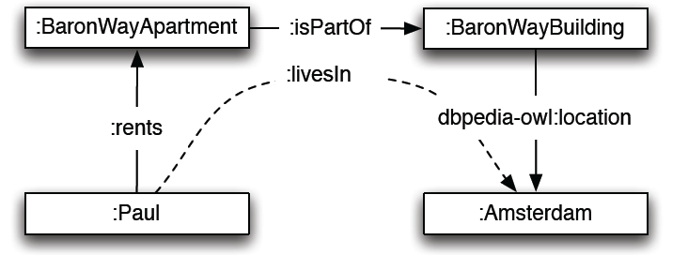
Property Chain Example
The property chain axiom does not make the named property (:livesIn) equivalent to the chain of properties
livesIn is a superproperty of the chain.
In OWL2 DL, property chains only involve object properties
Most reasoners can handle chains that have a datatype property as last step.

Slide 26
Keys
OWL 1 does not provide a means to define keys.
Keys are important to many applications to uniquely identify individuals of a given class by values of key properties.
The OWL 2 construct hasKey allows keys to be defined for a given class.
An hasKey axiom states that each named instance of a class is uniquely identified by a (data or object) property or a set of properties
If two named instances of the class coincide on values for each of key properties, then these two individuals are the same.
While in OWL 2 key properties are not required to be functional or total properties, it is always possible to separately state that a key property is functional, if desired.

Slide 27
Keys - Example
The combination of postcode and street address number is a unique identifier for any house
:postcode rdf:type owl:DatatypeProperty .
:addressNumber rdf:type owl:DatatypeProperty .
:House rdf:type owl:Class ;
owl:hasKey ( :postcode :addressNumber ) .

Slide 28
Extended datatype capabilities - Extra Datatypes and Datatype Restrictions
OWL 1
supports only for integers and strings as datatypes
E.g. one could state that every person has an age, which is an integer,
does not support any subsets of these datatypes.
E.g. one could not restrict the range of that datatype to say that adults have an age greater than 18.
OWL 2 provides new capabilities for datatypes:
supports a richer set of datatypes
supports restrictions of datatypes by facets, as in XML Schema.

Slide 29
Extra Datatypes
OWL 2 datatypes:
a) various kinds of numbers, adding support for a wider range of XML Schema Datatypes (double, float, decimal, positiveInteger, etc.) and providing its own datatypes, e.g., owl:real
b) strings with (or without) a Language Tag (using the rdf:PlainLiteral datatype)
c) boolean values, binary data, IRIs, time instants, etc.

Slide 30
Datatype Restrictions
Datatype Restrictions make possible to specify restrictions on datatypes by constraining facets that restrict the range of values allowed for a datatatype
by length (for strings) e.g., minLength, maxLength,
by minimum/maximum value (for numbers), e.g., minInclusive, maxInclusive.

Slide 31
Datatype Restriction - Example
:Adult rdfs:subClassOf dbpedia:Person ;
rdfs:subClassOf [ rdf:type owl:Restriction ;
owl:onProperty :hasAge ;
owl:someValuesFrom
[ rdf:type rdfs:Datatype ;
owl:onDatatype xsd:integer ;
owl:withRestrictions (
[ xsd:minInclusive "18"^^xsd:integer ])]].
:Adult is the subclass of persons that have a value for the :hasAge that falls within the range of integers equal to or larger than 18.
Data range is defined as anonymous class of type rdfs:Datatype

Slide 32
Simple meta-modeling capabilities – Punning
OWL 1 DL required a strict separation between the names of, e.g., classes and individuals.
OWL 2 DL relaxes this separation somewhat to allow different uses of the same term
e.g., Eagle, to be used for both a class, the class of all Eagles, and an individual, the individual representing the species Eagle belonging to the (meta)class of all plant and animal species.
However, OWL 2 DL still imposes certain restrictions
a name cannot be used for both a class and a datatype
a name can only be used for one kind of property

Slide 33
Top and Bottom Properties
While OWL 1 had only top and bottom predefined entities for classes (owl:Thing, owl:Nothing), OWL 2 also provides top and bottom object and data properties
owl:topObjectProperty, owl:bottomObjectProperty, owl:topDataProperty, owl:bottomDataProperty
All pairs of individuals are connected by owl:topObjectProperty
No individuals are connected by owl:bottomObjectProperty
All possible individuals are connected with all literals by owl:topDataProperty
No individual is connected by owl:bottomDataProperty to a literal.

Slide 34
Profiles
OWL only useful in practice if we can deal with large ontologies and/or large data sets
Unfortunately, OWL is worst case highly intractable
OWL 2 ontology satisfiability is 2NEXPTIME-complete
Possible solution is profiles: language subsets with useful computational properties
OWL defined one such profile: OWL Lite
Unfortunately, it isn’t tractable either! (EXPTIME-complete)

Slide 35
Profiles
OWL 2 defines three different tractable profiles:
EL: polynomial time reasoning for schema and data
Useful for ontologies with large conceptual part
QL: fast (logspace) query answering using RDBMs via SQL
Useful for large datasets already stored in RDBs
RL: fast (polynomial) query answering using rule-extended DBs
Useful for large datasets stored as RDF triples

Slide 36
OWL 2 EL
A (near maximal) fragment of OWL 2 such that
supports sound and complete reasoning in polynomial time
Was designed to cover the expressive power of large-scale ontologies with a large number of classes
Based on EL family of description logics
Existential (someValuesFrom) + conjunction
Most significant difference with OWL2 DL:
drops the owl:allValuesFrom restriction
supports rdfs:range restrictions, which can have a similar effect
Can exploit saturation based reasoning techniques
Computes classification in “one pass”

Slide 37
OWL 2 QL
A (near maximal) fragment of OWL 2 such that
Data complexity of conjunctive query answering
OWL2 QL was developed to efficiently handle query answering on ontologies with a large number of individual assertions and uncomplicated class definitions
Adopts technologies form relational database management.
Based on DL-Lite family of description logics
Existential (someValuesFrom) + conjunction (RHS only)
Can exploit query rewriting based reasoning technique
Computationally optimal
Data storage and query evaluation can be delegated to standard RDBMS

Slide 38
OWL 2 RL
A (near maximal) fragment of OWL 2 such that
Can be implemented using standard rule engines
Enables interaction between description logics and rules
Important because rules can efficiently run in parallel, allowing for highly scalable reasoning implementations
Closely related to Description Logic Programs (DLP)
No “existentials” on RHS
Can provide correctness guarantees
OWL2 RL bridges OWL DL - OWL Full:
Rule reasoners can disregard separation between classes and individuals
Rule implementations of OWL2 RL can implement subsets of OWL Full

